Slide 1

Year 5 Parent and Carer Secondary Transition Meeting

Slide 2
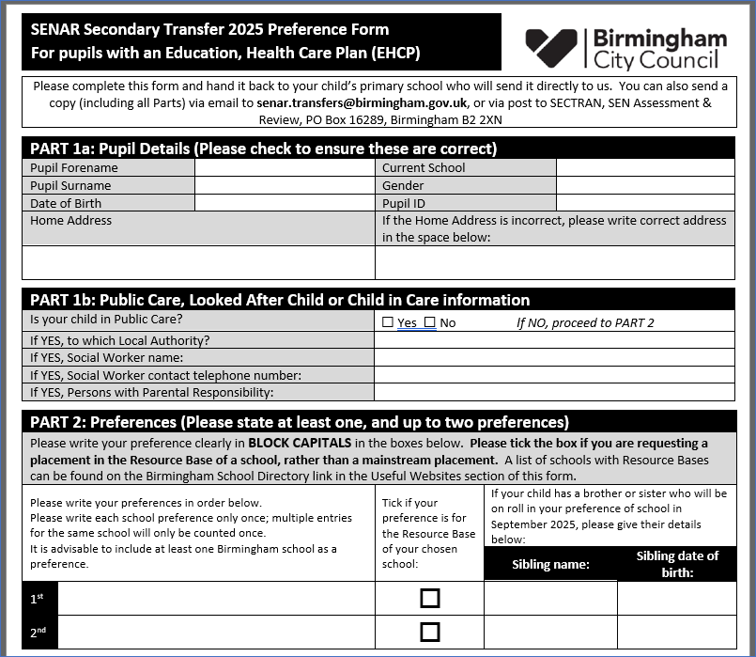
Secondary Transition Process
End of May/early June 2026 - information letter and preference form will be sent directly to you from SENAR. We will get copies so do not worry if you do not receive yours – please contact me by the middle of June if you do not receive one.

Slide 3
In terms of preference choices, I would not leave it at one.
At best I would be putting two choices – this will eliminate you being placed into clearing if you were unsuccessful on your one and only choice and being placed in a totally random setting.
The preference form does not come with a specific deadline – however – the sooner it is in the more efficient the process. We would advise that the form is sent into SENAR or returned to school for me by the end of the summer holidays.
The sooner the form is in the quicker we can secure a place for September 2027.

Slide 4
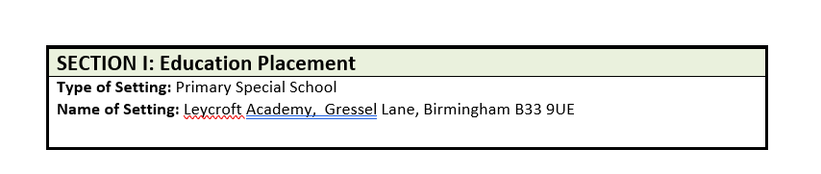

EHCP Process
By the end of May 2026 all Year 5 Annual Reviews will have been sent into SENAR and these will be used for submission to the secondary schools.
Based on the EHCP’s information the secondary settings you have chosen will determine if they can meet the need and requirements outlined
If the setting you have chosen can meet need they will inform SENAR that there is a place for your child in September and SENAR will write to you via email or letter to inform you of the proposed changes to section I.
You will then receive a notification from SENAR around the middle of March 2026 with a Notification of Final Amendment to your child’s EHCP and section I will state the appointed school.

Slide 5
Additional Info & Appeal Process
Additional Information required post-submission?
  Should personal circumstances change or new medical evidence is presented post your year 5 EHCP reviews and you feel it will be detrimental to your child’s year 7 placement we can call an early review.
  This will need to be put before a panel as to why we would want to call an early review and if they agree with the evidence presented then they will agree to a new review.
  This will need to be done ASAP during the Autumn term so please contact me or the class teacher ASAP if anything occurs.
You are unhappy with the placement or have no placement?
  Along side the Final Notice of Amendment will be the right to appeal – there will be instructions within the body of the letter telling you how to go about this and I will be here to support as well.
  You will be contesting Section I and the appeal paperwork will be asking the reasons as to why you are appealing.
  These can be a variety of reasons from distance, not being able to meet your child’s needs or setting is unsuitable etc
  This will need to be submitted ASAP as this can take a while – both schools will be sent tribunal papers to respond to the appeal and then the appeal will need be heard before a judge. On the whole this process should complete before the end of the summer term but can go into the summer break.

Slide 6
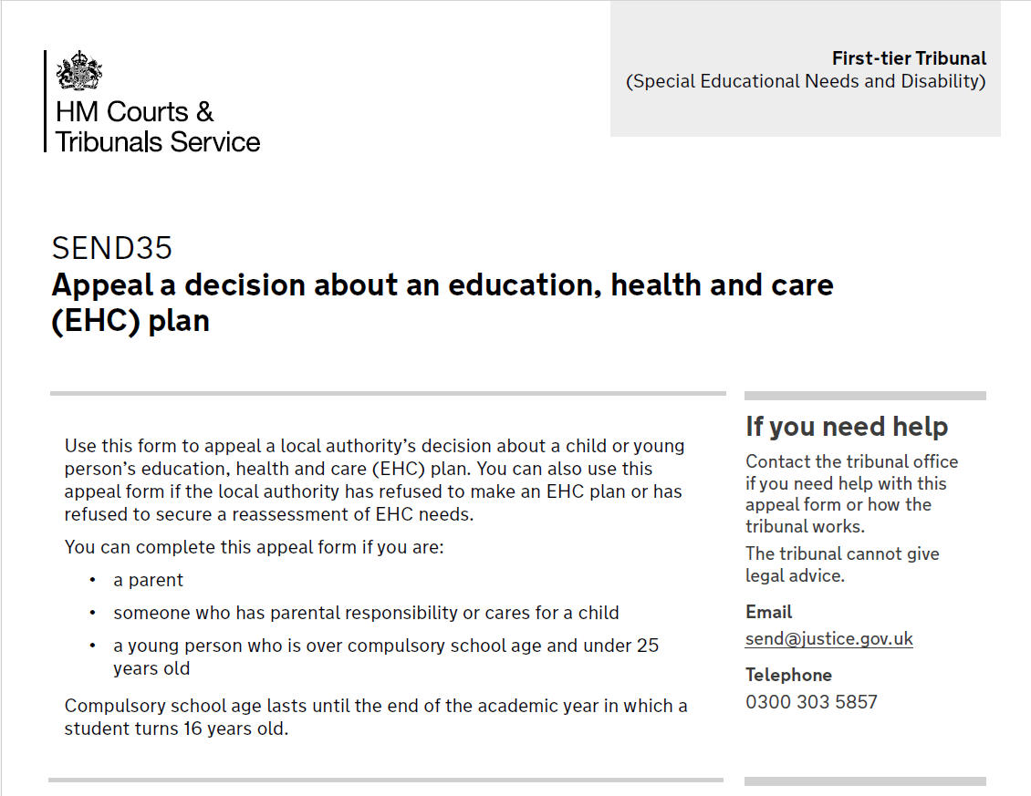

Slide 7
Secondary Schools that our children have moved onto
Baskerville School
Hallmoor School
Oscott Manor School
The Pines School
Uffculme School
Calthorpe Academy
Queensbury School
Selly Oak Trust
The Heights
However, there are other independent specialist settings within the midlands and advise that you research fully before making your preference lists final.
Special - Birmingham Schools | Birmingham City Council

Slide 8

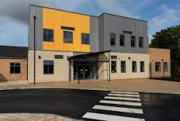
Hallmoor School
All of the children who attend Hallmoor School have a Statement of Special Educational Need or an Education and Health Care Plan. Our school educates children with cognition and learning needs. Children may have Severe Learning Difficulties (SLD), Moderate Learning Difficulties (MLD), Speech Language and Communication Difficulties or a diagnosis of Autistic Spectrum Disorder (ASD). Some children have additional needs including visual impairment and hearing impairment and associated behaviour difficulties.
OFSTED rating : Good, 2023
Hallmoor School
50 Scholars Gate
Birmingham
B33 0DL
0121 803 1620
enquiry@hallmoor.fet.ac

Slide 9
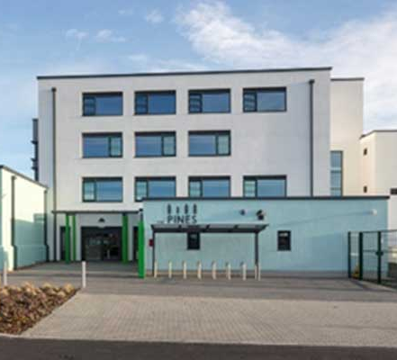
The Pines School
The Pines School is an all age ASC specific school and have provision for 244 young people from all over Birmingham aged 3 – 16.
OFSTED rating: Good, 2025
The Pines School, Marsh Hill, Birmingham, B23 7EY, 0121 464 6136, enquiry@pines.bham.sch.uk .bham.sch.uk

Slide 10
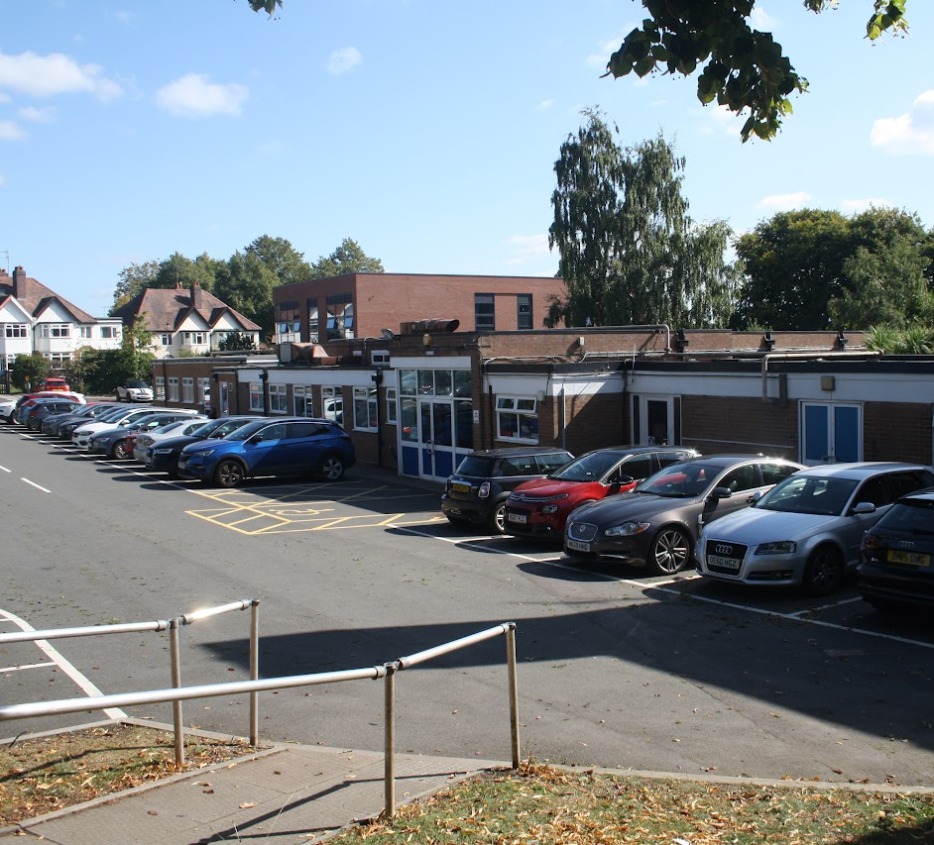
Baskerville School
Baskerville is a day and residential school for 149 secondary age students between 11 and 19 with autism and additional disability.
OFSTED rating Good, 2022
Baskerville School, Fellows Lane, Harborne, B17 9TS, 01214273191, www.baskerville.school , enquires@baskvill.bham.sch.uk

Slide 11
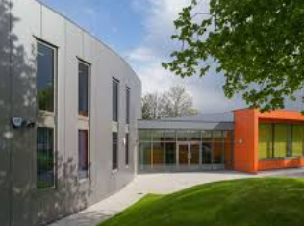
Calthorpe
Calthorpe is a day and residential school for 450 secondary age students between 2 and 19 with autism and additional disability.
OFSTED rating Good, 2023
Calthorpe Academy
Darwin Street
Highgate Birmingham
B12 0TP
0121 773 4637
enquiry@calthorpe.thrive.ac

Slide 12
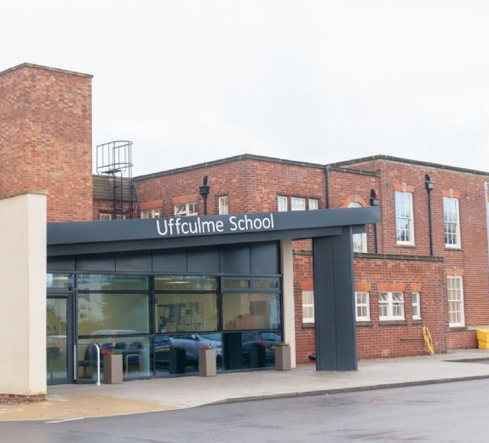
Uffculme School
Uffculme School’s KS3 and KS4 students (11-16 years) are primarily based at Chamberlain House, which is situated 400 metres from our primary building. Our Russell Road building (400 metres from Chamberlain House) caters for KS5 (students aged 16-19 yrs) who have the most complex ASD needs. The education here focuses on preparing the students for adult life with an emphasis on daily living skills.
OFSTED Rating : Outstanding, 2025
Chamberlain site: 2 Yew Tree Road
Moseley, B13 8QG, 0121 464 9634, enquiry@uffculme.bham.sch.uk

Slide 13
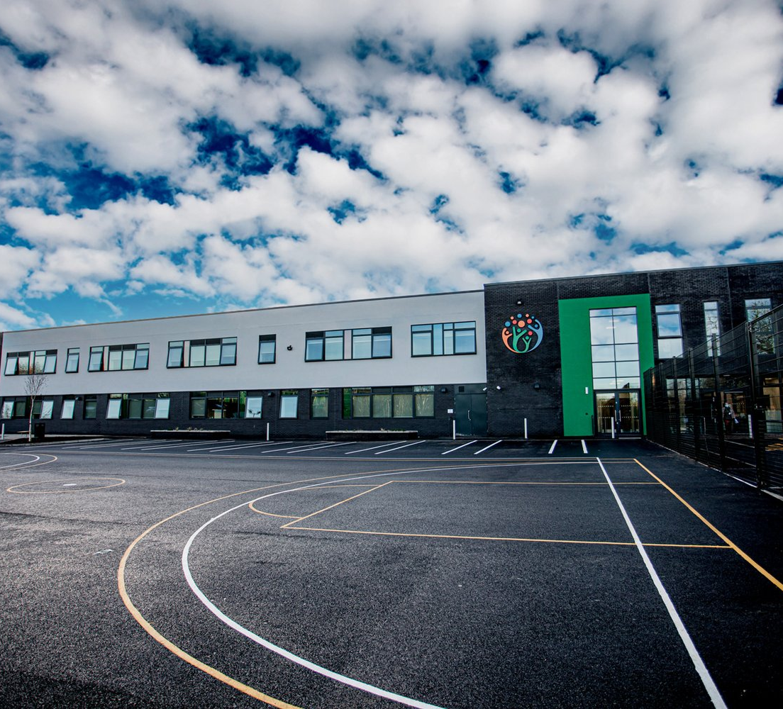
Oscott Manor School
Oscott Manor is a community special school providing education for autistic children and young people aged between 11 and 19.
OFSTED rating: Inadequate 2024
Oscott Manor School, 290 Reservoir Road
Erdington, Birmingham, B23 6DE, enquiry@oscottmanor.bham.sch.uk, 0121 360 8222
Switchboard open 8:00am - 4:00pmOscott Manor School. Ours is a vibrant

